Slide 1

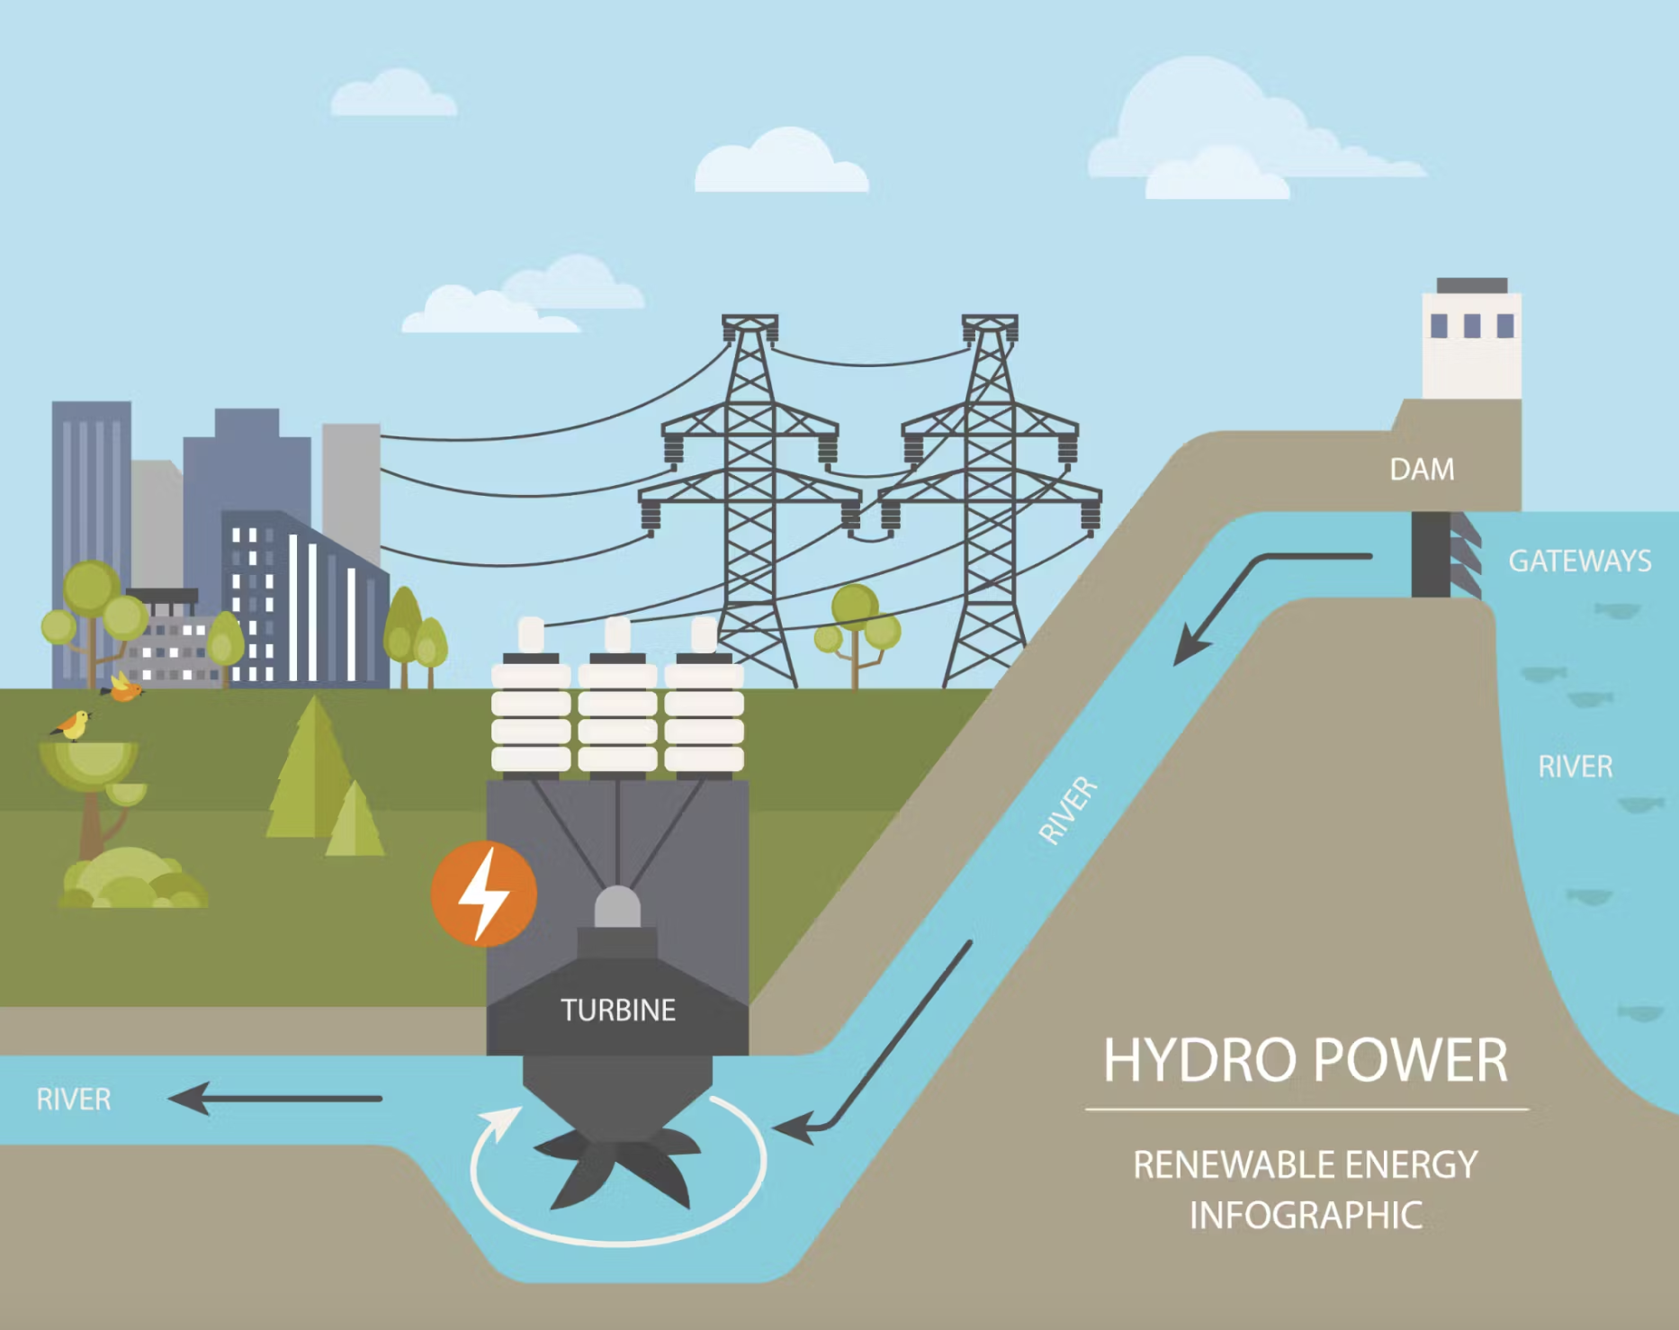



Uganda Government: Asset management implementation for a Hydro Power Plant (HPP)
Applying expertise in configuring Maximo for asset management, maintenance planning, KKS Code Integration, and ERP/DMS Interfaces integration in Uganda
Sedin partnered with the Uganda government for workshops and real-time prototyping, ensuring tailored solutions and smooth adoption with continuous support.
Challenge
Benefits
Regulatory challenges in managing permit and risk assessment workflows efficiently.
Poor internet connectivity hindered data synchronization and cloud access.
Need for extensive customization and automation to align with plant operations.
Digitized manual systems, cutting delays and streamlining operations.
Boosted uptime and reduced breakdowns with preventive maintenance.
Enabled mobile work requests, improving responsiveness and resolution times.
Leveraged MTTR and MTBF for continuous improvement.
Solution
Deployed IBM Maximo for efficient asset management, maintenance, and workflows.
Integrated Maximo Scheduler to optimize maintenance and boost reliability.
Implemented structured KKS code uploads for seamless asset identification.
Integrated with MS Dynamics (ERP) and OpenText Documentum (DMS) for smooth data and document management.
Digitized calibration processes and streamlined field work requests with EAM360.
Technologies
Notes:
System Uptime: Achieved over 98% system availability post-implementation.
Maintenance Efficiency: Reduced corrective maintenance instances by 20% within the first six months.
Work Order Processing Time: Decreased average work order completion time by 30%.
Data Accuracy: Achieved over 95% accuracy in asset and location data with the KKS code upload.
Training Completion Rate: 100% of end-users successfully completed the training program, ensuring smooth transition and operational effectiveness.

